Slide 1
Incident Response Station
IR 101 Track
Module 2: IR lifecycle AND Frameworks

Slide 2

Outline
What is an incident response lifecycle?
Why we use a framework?
The how?
Credit: https://gadugicomms.files.wordpress.com/2014/06/wonka_crisis1.jpg

Slide 3
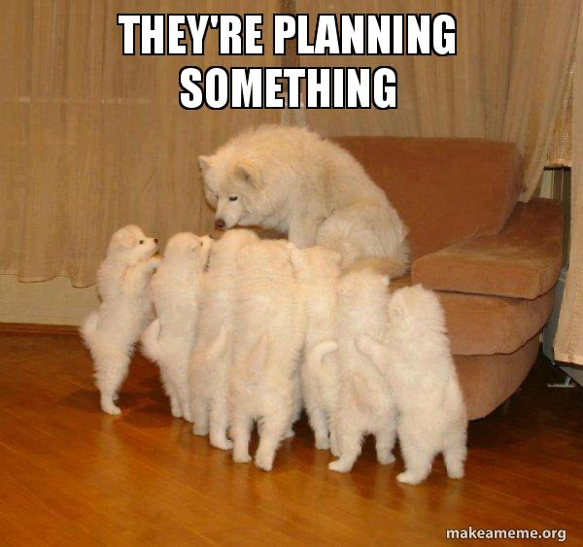
Why we use a framework? – The what
To
Provide us a structure – The what
Help in creating an incident response plan
Guiding Incident Response activity

Slide 4
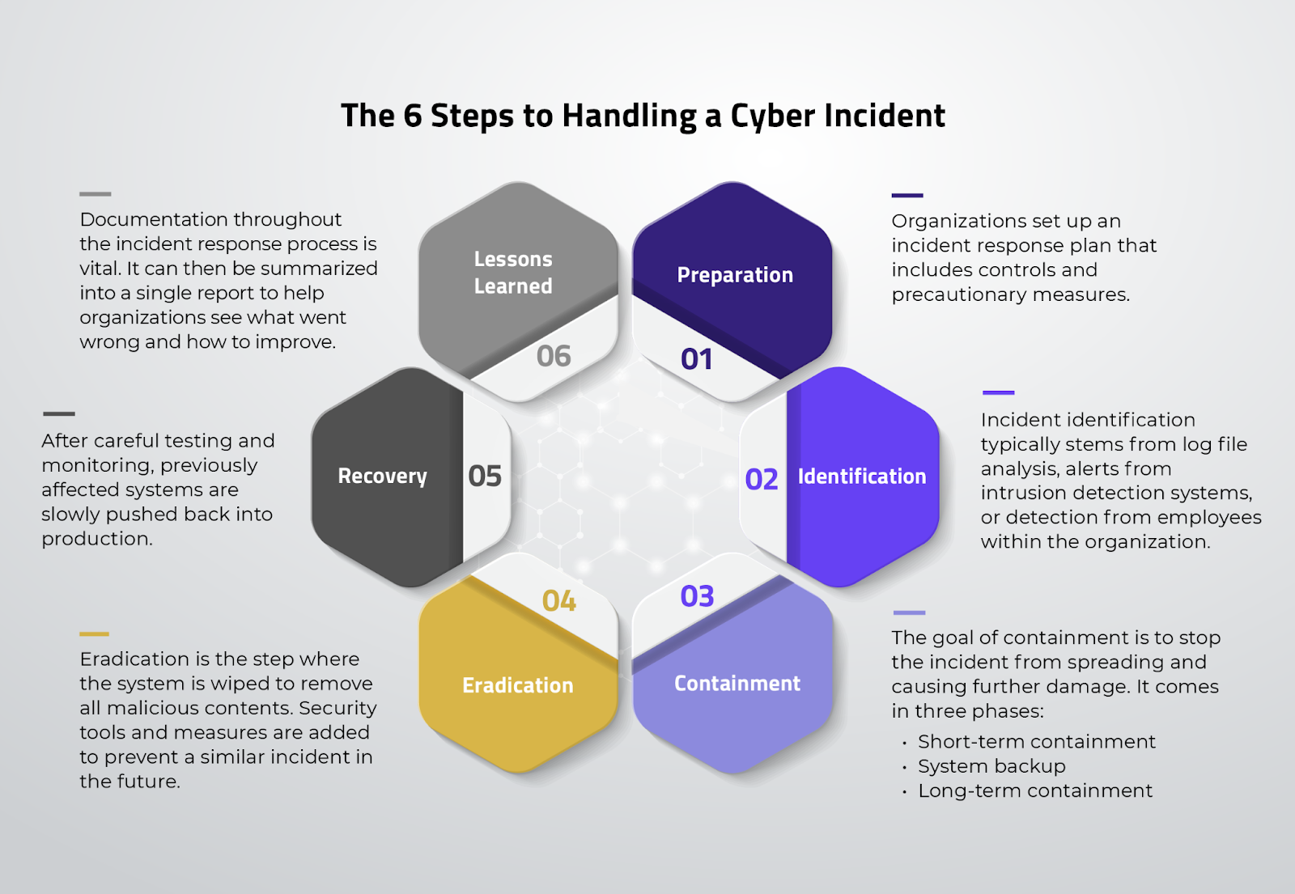
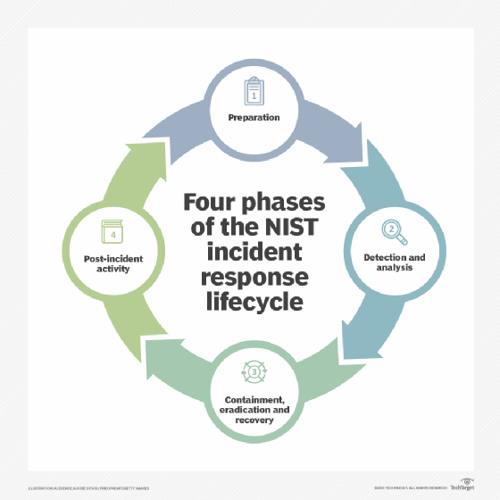
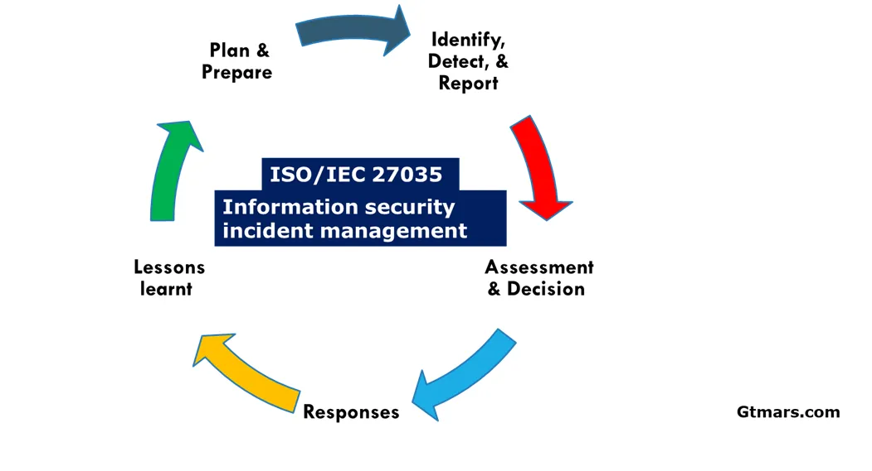
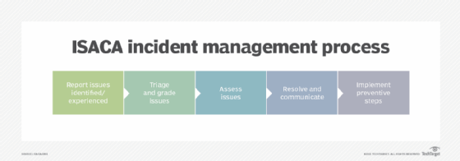
What is an incident response lifecycle? – The what
Credit: https://www.techtarget.com/searchsecurity/tip/Incident-response-frameworks-for-enterprise-security-teams

Slide 5
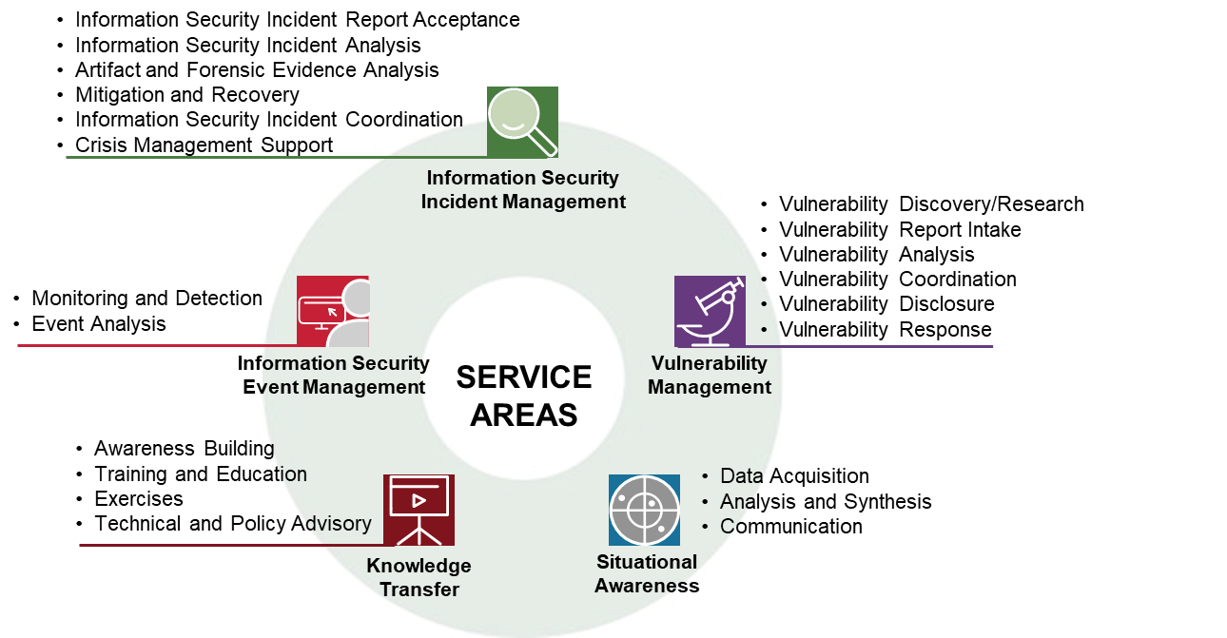
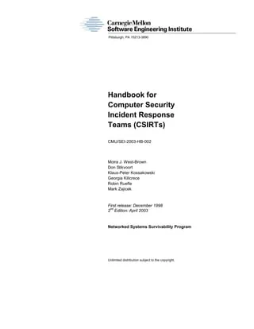
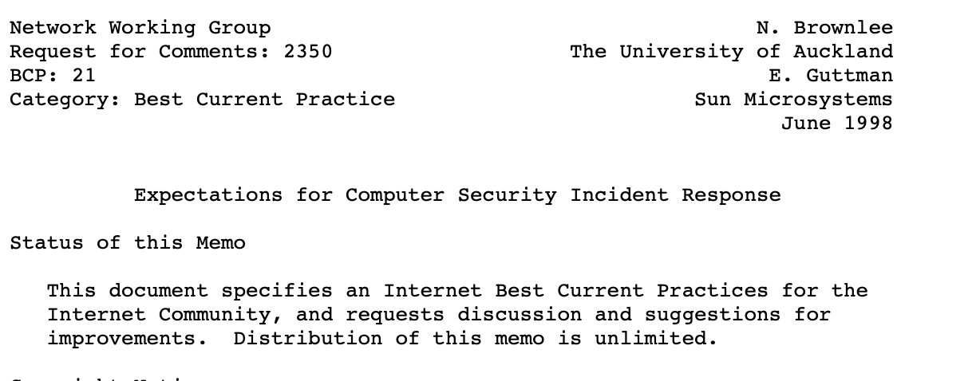
The How?
Credit:https://www.first.org/standards/frameworks/csirts/csirt_services_framework_v2.1

Slide 6
Why we use a framework? – The what
NIST Primarily focuses on organizational level
Provides clear steps on creating a IR plan
Models for IR Team
FIRST Services Framework provide services and functions
What they do (responsibilities)
What is the expected outcome
SANS PICERL focuses on technical level
Provides guidance on HOW
Checklists for different scenarios

Slide 7
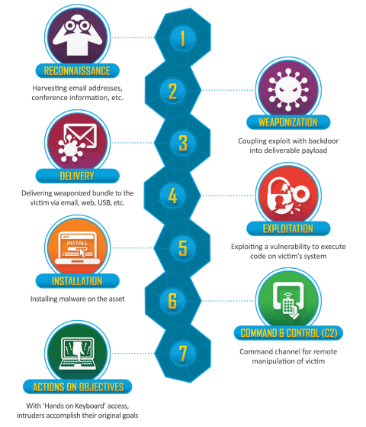
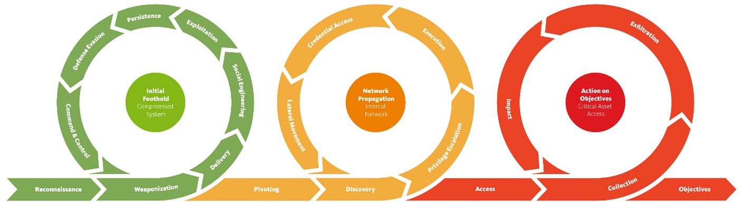

The How?

Slide 8
Why we use a these? – The How
Can be used in various way in both planning and operations
For planning, MITRE ATT&CK helps in playbooks, knowledge base, training
MITRE D3FEND helps in
countermeasure components and capabilities
can be used to develop solutions in the after math of an incident
relationship between artifacts and abstractions through Digital
cyber kill-chain is similar to MITRE ATT&CK BUT only gives you higher level goals
detect, deny, disrupt, degrade, contain are interpreted by the community rather than being spelled out
Both MITRE ATTA&CK and kill chain can be mapped out to controls and

